Slide 1














Locating and Connecting Nearby Workers
Enhancing Client-Provider Interactions with Real-Time Request Management

Slide 2

Introduction to ServiceLinker
ServiceLinker Overview:
Connects clients with nearby workers.
Facilitates real-time requests and responses
Key Features:
Clients can search for workers by location.
Workers can log in, check for requests, and accept or reject work.

Slide 3
01.
Programming Language:
Python 3.11
Technologies Used
User Interface:
Tkinter for creating the GUI.
02.
Python 3.11: Core programming language for backend development.
Tkinter: Python's standard GUI toolkit for creating user interfaces.
Socket Programming: Facilitates real-time communication between clients, server, and providers.
Pickle: Handles serialization of data for efficient transmission and storage.
Networking:
Socket programming for client-server communication.
03.
04.
Data Serialization:
Pickle for data exchange between client and server.

Slide 4
System Architecture
01
02
03
04
Components:
Client Application
Server
Provider Application
Client:
Searches for workers
Sends requests to the server
Server:
Manages requests
Forwards requests to providers
Provider:
Logs in and checks for requests
Accepts or rejects work

Slide 5
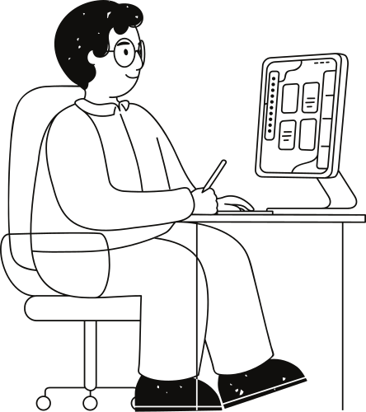
Client User Interface
Features:
Service selection
Location selection
Provider selection
Request submission

Slide 6
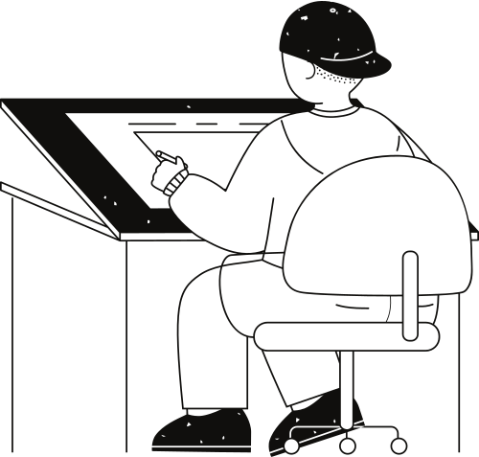
Provider User Interface
Features:
Login screen
Request list display
Accept/reject request functionality

Slide 7
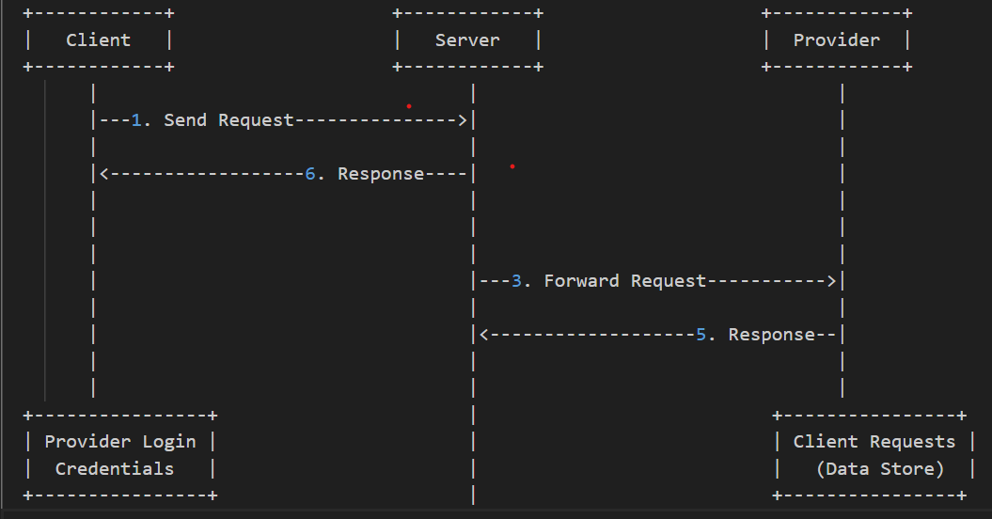
Data Flow Diagram
Visual Representation:

Slide 8

Conclusion and Q&A
Summary:
ServiceLinker connects clients with providers efficiently.
Real-time request and response system.
Future Enhancements:
Add more services and locations.
Improve security and scalability.

Slide 9
Thank you very much!

